Slide 1
Data Science
Chapter 3 Classification: Basics and Algorithms
1

Slide 2
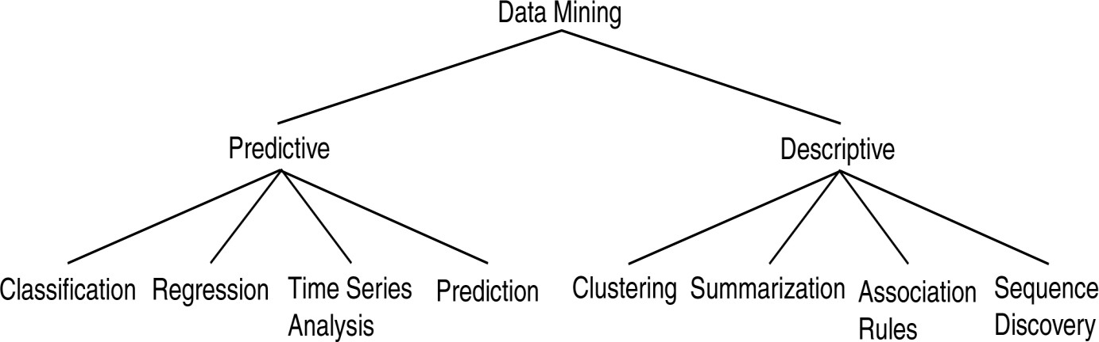
Data Mining Models and Tasks
2
Chapter 1 - Introduction Data Mining

Slide 3
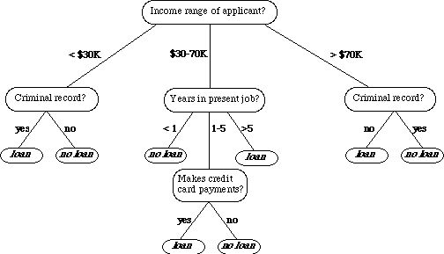
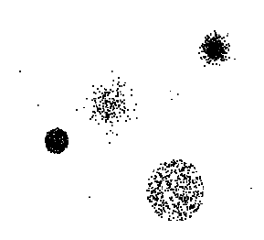


Data Mining Tasks
Data
Tid | Refund | Marital Status | Taxable Income | Cheat
1 | Yes | Single | 125K | No
2 | No | Married | 100K | No
3 | No | Single | 70K | No
4 | Yes | Married | 120K | No
5 | No | Divorced | 95K | Yes
6 | No | Married | 60K | No
7 | Yes | Divorced | 220K | No
8 | No | Single | 85K | Yes
9 | No | Married | 75K | No
10 | No | Single | 90K | Yes
11 | No | Married | 60K | No
12 | Yes | Divorced | 220K | No
13 | No | Single | 85K | Yes
14 | No | Married | 75K | No
15 | No | Single | 90K | Yes
10
Milk
Chapter 1 - Introduction Data Mining
3

Slide 4
Basic Data Mining Tasks
Classification maps data into predefined groups or classes
Supervised learning
Pattern recognition
Prediction
Regression is used to map a data
item to a real valued prediction variable.
Clustering groups similar data together into clusters.
Unsupervised learning
Segmentation
Partitioning
4
Chapter 1 - Introduction Data Mining

Slide 5
Classification: Definition
Given a collection of records (training set )
Each record is characterized by a tuple (x,y), where x is the attribute set and y is the class label
x: attribute, predictor, independent variable, input
y: class, response, dependent variable, output
Task:
Learn a model that maps each attribute set x
into one of the predefined class labels y
5

Slide 6
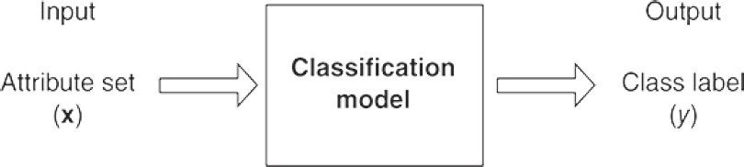
Classification Task
6

Slide 7
Examples of Classification Task
Task | Attribute set, x | Class label, y
Categorizing email messages | Features extracted from email message header and content | spam or non-spam
Identifying tumor cells | Features extracted from x-rays or MRI scans | malignant or benign cells
Cataloging galaxies | Features extracted from telescope images | Elliptical, spiral, or irregular-shaped galaxies
7

Slide 8
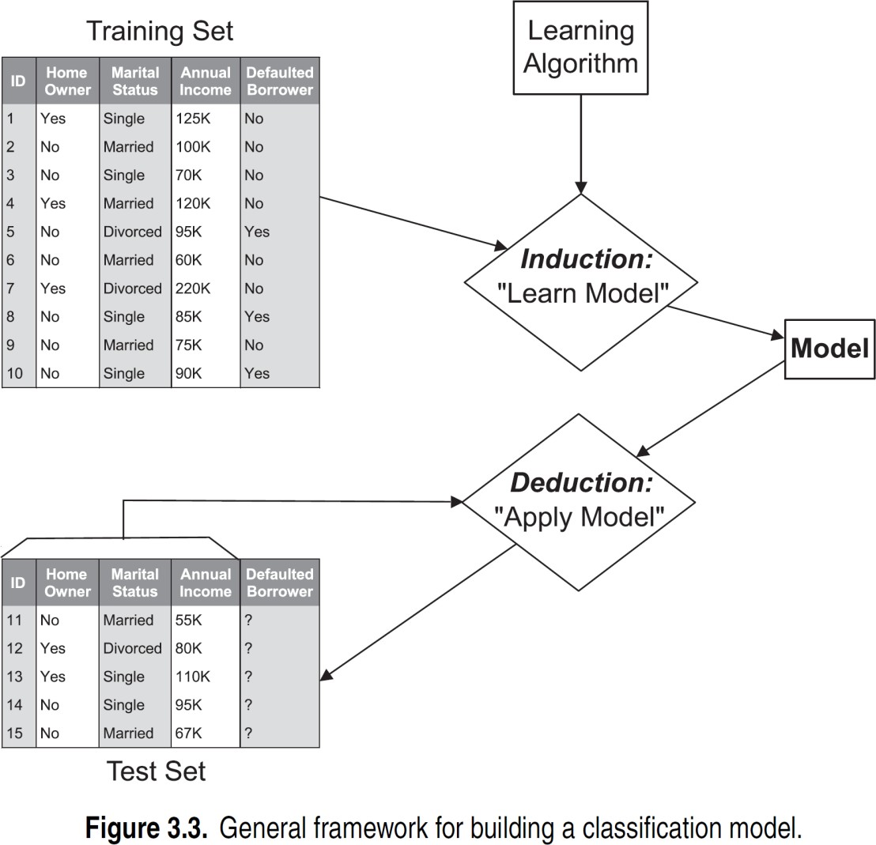
General Framework for Classification
8

Slide 9
General Framework for Classification
Classification is the task of assigning labels to unlabeled data instances and a classifier is used to perform such a task
A classifier is typically described in terms of a model
The model is created using a given a set of instances, known as the training set, which contains attribute values as well as class labels for each instance
The systematic approach for learning a classification model given a training set is known as a learning algorithm
9

Slide 10
General Framework for Classification
The process of using a learning algorithm to build a classification model from the training data is known as induction
This process is also often described as “learning a model” or “building a model.”
This process of applying a classification model on unseen test instances to predict their class labels is known as deduction
Thus, the process of classification involves two steps: applying a learning algorithm to training data to learn a model, and then applying the model to assign labels to unlabeled instances

Slide 11
Classification Techniques
Base Classifiers
Decision Tree based Methods
Rule-based Methods
Nearest-neighbor
Naïve Bayes and Bayesian Belief Networks
Support Vector Machines
Neural Networks, Deep Neural Nets

Slide 12
Decision Tree classifier
A decision tree is tree in which each branch node represents a choice between a number of alternatives and each leaf node represents a classification or decision.
Decision tree is a classifier in the form of a tree structure where a leaf node indicates the class of instances, a decision node specifies some test to be carried out on a single attribute value with one branch and sub-tree for each possible outcome of the test.
A decision tree can be used to classify an instance by starting at root of the tree and moving through it until leaf node. The leaf node provides the corresponding class of instance.

Slide 13
Nodes in Decision Tree
A root node, with no incoming links and zero or more outgoing links
Internal nodes, each of which has exactly one incoming link and two or more outgoing links
Leaf or terminal nodes, each of which has exactly one incoming link and no outgoing links
Every leaf node in the decision tree is associated with a class label
The nonterminal nodes, which include the root and internal nodes, contain attribute test conditions that are typically defined using a single attribute
Each possible outcome of the attribute test condition is
associated with exactly one child of this node

Slide 14
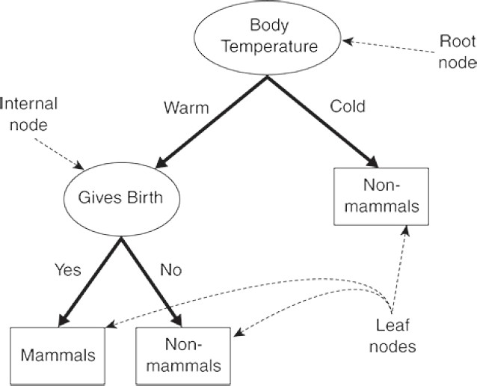
Nodes in Decision Tree

Slide 15

Example of a Decision Tree
Splitting Attributes
 |  |  |  | Home Owner |  |  | Marital Status |  |  | Annual Income |  |  | Defaulted Borrower
 | ID
1 |  |  | Yes |  |  | Single |  |  | 125K |  |  | No
2 |  |  | No |  |  | Married |  |  | 100K |  |  | No
3 |  |  | No |  |  | Single |  |  | 70K |  |  | No
4 |  |  | Yes |  |  | Married |  |  | 120K |  |  | No
5 |  |  | No |  |  | Divorced |  |  | 95K |  |  | Yes
6 |  |  | No |  |  | Married |  |  | 60K |  |  | No
7 |  |  | Yes |  |  | Divorced |  |  | 220K |  |  | No
8 |  |  | No |  |  | Single |  |  | 85K |  |  | Yes
9 |  |  | No |  |  | Married |  |  | 75K |  |  | No
10 |  |  | No |  |  | Single |  |  | 90K |  |  | Yes
Home Owner
Yes
No
NO
MarSt
Single, Divorced
Married
Income
NO
< 80K
> 80K
NO
YES
10
Training Data
Model: Decision Tree

Slide 16
Apply Model to Test Data
Test Data
Start from the root of tree.
 | Home Owner |  |  | Marital Status |  |  | Annual Income |  |  | Defaulted Borrower
No |  |  | Married |  |  | 80K |  |  | ?
Home Owner
10
Yes
No
NO
MarSt
Single, Divorced
Married
Income
NO
< 80K
> 80K
NO
YES

Slide 17
Apply Model to Test Data
Test Data
 | Home Owner |  |  | Marital Status |  |  | Annual Income |  |  | Defaulted Borrower
No |  |  | Married |  |  | 80K |  |  | ?
Home Owner
10
Yes
No
NO
MarSt
Single, Divorced
Married
Income
NO
< 80K
> 80K
NO
YES

Slide 18
Apply Model to Test Data
Test Data
 | Home Owner |  |  | Marital Status |  |  | Annual Income |  |  | Defaulted Borrower
No |  |  | Married |  |  | 80K |  |  | ?
Home Owner
10
Yes
No
NO
MarSt
Single, Divorced
Married
Income
NO
< 80K
> 80K
NO
YES

Slide 19
Apply Model to Test Data
Test Data
 | Home Owner |  |  | Marital Status |  |  | Annual Income |  |  | Defaulted Borrower
No |  |  | Married |  |  | 80K |  |  | ?
Home Owner
10
Yes
No
NO
MarSt
Single, Divorced
Married
Income
NO
< 80K
> 80K
NO
YES

Slide 20
Apply Model to Test Data
Test Data
 | Home Owner |  |  | Marital Status |  |  | Annual Income |  |  | Defaulted Borrower
No |  |  | Married |  |  | 80K |  |  | ?
Home Owner
10
Yes
No
NO
MarSt
Single, Divorced
Married
Income
NO
< 80K
> 80K
NO
YES

Slide 21
Apply Model to Test Data
Test Data
 | Home Owner |  |  | Marital Status |  |  | Annual Income |  |  | Defaulted Borrower
No |  |  | Married |  |  | 80K |  |  | ?
Home Owner
10
Yes
No
NO
MarSt
Married
Assign Defaulted to “No”
Single, Divorced
Income
NO
< 80K
> 80K
NO
YES

Slide 22

Another Example of Decision Tree
MarSt
Single,
Divorced
Married
 |  |  |  | Home Owner |  |  | Marital Status |  |  | Annual Income |  |  | Defaulted Borrower
 | ID
1 |  |  | Yes |  |  | Single |  |  | 125K |  |  | No
2 |  |  | No |  |  | Married |  |  | 100K |  |  | No
3 |  |  | No |  |  | Single |  |  | 70K |  |  | No
4 |  |  | Yes |  |  | Married |  |  | 120K |  |  | No
5 |  |  | No |  |  | Divorced |  |  | 95K |  |  | Yes
6 |  |  | No |  |  | Married |  |  | 60K |  |  | No
7 |  |  | Yes |  |  | Divorced |  |  | 220K |  |  | No
8 |  |  | No |  |  | Single |  |  | 85K |  |  | Yes
9 |  |  | No |  |  | Married |  |  | 75K |  |  | No
10 |  |  | No |  |  | Single |  |  | 90K |  |  | Yes
NO
Home Owner
Yes
No
NO
Income
< 80K
> 80K
NO
YES
There could be more than one tree that
fits the same data!
10

Slide 23

Decision Tree Classification Task
Tree Induction algorithm
Induction
Tid | Attrib1 | Attrib2 | Attrib3 | Class
1 | Yes | Large | 125K | No
2 | No | Medium | 100K | No
3 | No | Small | 70K | No
4 | Yes | Medium | 120K | No
5 | No | Large | 95K | Yes
6 | No | Medium | 60K | No
7 | Yes | Large | 220K | No
8 | No | Small | 85K | Yes
9 | No | Medium | 75K | No
10 | No | Small | 90K | Yes
Learn Model
10
Training Set
Model
Apply Model
Decision Tree
Tid | Attrib1 | Attrib2 | Attrib3 | Class
11 | No | Small | 55K | ?
12 | Yes | Medium | 80K | ?
13 | Yes | Large | 110K | ?
14 | No | Small | 95K | ?
15 | No | Large | 67K | ?
Deduction
10
Test Set

Slide 24
Decision Tree Induction
Many Algorithms:
Hunt’s Algorithm (one of the earliest)
CART
– ID3, C4.5
SLIQ,SPRINT

Slide 25
Hunt’s Algorithm
In Hunt's algorithm, a decision tree is grown in a recursive fashion
The tree initially contains a single root node that is associated with all the training instances
If a node is associated with instances from more than one class, it is expanded using an attribute test condition that is determined using a splitting criterion
A child leaf node is created for each outcome of the attribute test condition and the instances associated with the parent node are distributed to the children based on the test outcomes

Slide 26
Hunt’s Algorithm
This node expansion step can then be recursively applied to each child node, as long as it has labels of more than one class
If all the instances associated with a leaf node have identical class labels, then the node is not expanded any further
Each leaf node is assigned a class label that occurs most frequently in the training instances associated with the node

Slide 27
General Structure of Hunt’s Algorithm
Let D be the set of training
 | Home Owner | Marital Status | Annual Income | Defaulted Borrower
ID
1 | Yes | Single | 125K | No
2 | No | Married | 100K | No
3 | No | Single | 70K | No
4 | Yes | Married | 120K | No
5 | No | Divorced | 95K | Yes
6 | No | Married | 60K | No
7 | Yes | Divorced | 220K | No
8 | No | Single | 85K | Yes
9 | No | Married | 75K | No
10 | No | Single | 90K | Yes
t
records that reach a node t
General Procedure:
– If D_{t} contains records that belong the same class y_{t}, then t is a leaf node
labeled as y
t
– If D_{t} contains records that belong to more than one class, use an attribute test to split the data into smaller subsets. Recursively apply the procedure to each subset.
10
D_{t}
?

Slide 28
Hunt’s Algorithm
Home
Owner
Yes No
Defaulted = No Defaulted = No
(3,0) (4,3)
(b)
 | Home Owner | Marital Status | Annual Income | Defaulted Borrower
ID
1 | Yes | Single | 125K | No
2 | No | Married | 100K | No
3 | No | Single | 70K | No
4 | Yes | Married | 120K | No
5 | No | Divorced | 95K | Yes
6 | No | Married | 60K | No
7 | Yes | Divorced | 220K | No
8 | No | Single | 85K | Yes
9 | No | Married | 75K | No
10 | No | Single | 90K | Yes
Defaulted = No
(7,3)
(a)
Home
Owner
Yes No
Defaulted = No Marital Status
Home
Owner
Yes No
Defaulted = No ^{Marital}
Status
(3,0) Single,
Divorced ^{Married}
Defaulted = Yes Defaulted = No
(1,3) (3,0)
(c)
10
(3,0) Single,
Divorced ^{Married}
_{Annual} Defaulted = No
Income _{(3,0)}
< 80K >= 80K
Defaulted = No Defaulted = Yes
(1,0) (0,3)
(d)

Slide 29
Hunt’s Algorithm
Home Owner
 | Home Owner | Marital Status | Annual Income | Defaulted Borrower
ID
1 | Yes | Single | 125K | No
2 | No | Married | 100K | No
3 | No | Single | 70K | No
4 | Yes | Married | 120K | No
5 | No | Divorced | 95K | Yes
6 | No | Married | 60K | No
7 | Yes | Divorced | 220K | No
8 | No | Single | 85K | Yes
9 | No | Married | 75K | No
10 | No | Single | 90K | Yes
Defaulted = No
Yes
No
Defaulted = No
Defaulted = No
(7,3)
(3,0)
(4,3)
(a)
(b)
Home
Owner
Yes No
Defaulted = No Marital Status
Home
Owner
Yes No
Defaulted = No ^{Marital}
Status
(3,0) Single,
Divorced ^{Married}
Defaulted = Yes Defaulted = No
(1,3) (3,0)
(c)
10
(3,0) Single,
Divorced ^{Married}
_{Annual} Defaulted = No
Income _{(3,0)}
< 80K >= 80K
Defaulted = No Defaulted = Yes
(1,0) (0,3)
(d)

Slide 30
Hunt’s Algorithm
Home Owner
 | Home Owner | Marital Status | Annual Income | Defaulted Borrower
ID
1 | Yes | Single | 125K | No
2 | No | Married | 100K | No
3 | No | Single | 70K | No
4 | Yes | Married | 120K | No
5 | No | Divorced | 95K | Yes
6 | No | Married | 60K | No
7 | Yes | Divorced | 220K | No
8 | No | Single | 85K | Yes
9 | No | Married | 75K | No
10 | No | Single | 90K | Yes
Defaulted = No
Yes
No
Defaulted = No
Defaulted = No
(7,3)
(3,0)
(4,3)
(a)
(b)
Home
Owner
Yes No
Defaulted = No Marital Status
Home Owner
Yes
No
10
Defaulted = No
Marital Status
(3,0) Single,
Divorced ^{Married}
_{Annual} Defaulted = No
Income _{(3,0)}
< 80K >= 80K
Defaulted = No Defaulted = Yes
(1,0) (0,3)
(d)
(3,0)
Single, Divorced
Married
Defaulted = Yes
Defaulted = No
(1,3)
(3,0)
(c)

Slide 31
Hunt’s Algorithm
Home Owner
 | Home Owner | Marital Status | Annual Income | Defaulted Borrower
ID
1 | Yes | Single | 125K | No
2 | No | Married | 100K | No
3 | No | Single | 70K | No
4 | Yes | Married | 120K | No
5 | No | Divorced | 95K | Yes
6 | No | Married | 60K | No
7 | Yes | Divorced | 220K | No
8 | No | Single | 85K | Yes
9 | No | Married | 75K | No
10 | No | Single | 90K | Yes
Defaulted = No
Yes
No
Defaulted = No
Defaulted = No
(7,3)
(3,0)
(4,3)
(a)
(b)
Home Owner
Home Owner
Yes
No
Defaulted = No
Marital Status
Yes
No
10
(3,0) Single,
Divorced
Married
Defaulted = No
Marital Status
(3,0)
Single, Divorced
Annual Income
Defaulted = No
Married
(3,0)
Defaulted = Yes
Defaulted = No
< 80K
>= 80K
(1,3)
(3,0)
Defaulted = No
Defaulted = Yes
(1,0)
(0,3)
(c)
(d)

Slide 32
Design Issues of Decision Tree Induction
How should training records be split?
Method for expressing test condition
depending on attribute types
Measure for evaluating the goodness of a test condition
How should the splitting procedure stop?
Stop splitting if all the records belong to the same class or have identical attribute values
Early termination

Slide 33
Methods for Expressing Test Conditions
Depends on attribute types
Binary
Nominal
Ordinal
Continuous

Slide 34
Test Condition for Nominal Attributes
Multi-way split:
– Use as many partitions as distinct values.
Marital Status
Single
Divorced
Married
Binary split:
– Divides values into two subsets
Marital Status
Marital Status
Marital Status
OR
OR
{Married}
{Single, Divorced}
{Single}
{Married, Divorced}
{Single, Married}
{Divorced}

Slide 35
Test Condition for Ordinal Attributes
Multi-way split:
– Use as many partitions as distinct values
Shirt Size
Small
Extra Large
Medium
Large
Binary split:
Divides values into two subsets
Preserve order property among attribute values
Shirt Size
Shirt Size
{Small, Medium}
{Large, Extra Large}
{Small}
{Medium, Large, Extra Large}
Shirt Size
This grouping violates order property
{Small, Large}
{Medium, Extra Large}

Slide 36
Test Condition for Continuous Attributes
Annual Income
> 80K?
Annual Income?
< 10K
> 80K
Yes
No
[10K,25K)
[25K,50K)
[50K,80K)
(i) Binary split
(ii) Multi-way split

Slide 37
Splitting Based on Continuous Attributes
Different ways of handling
Discretization to form an ordinal categorical attribute
Ranges can be found by equal interval bucketing, equal frequency bucketing (percentiles), or clustering.
Static – discretize once at the beginning
Dynamic – repeat at each node
Binary Decision: (A < v) or (A ≥ v)
consider all possible splits and finds the best cut
can be more compute intensive

Slide 38
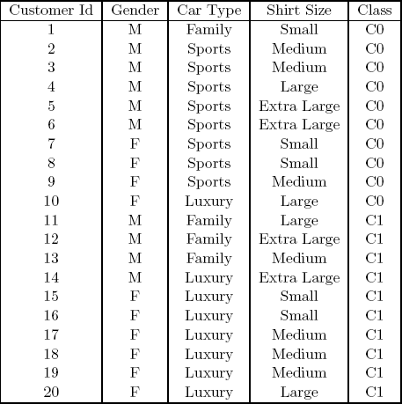
How to determine the Best Split
Before Splitting: 10 records of class 0,
10 records of class 1
Gender
Car Type
Customer ID
Family
Sports
Luxury
c₁
Yes
No
^{c}20
^{c}10 ^{c}11
C0: 6
C1: 4
C0: 4
C1: 6
C0: 1
C1: 3
C0: 8
C1: 0
C0: 1
C1: 7
C0: 1
C1: 0
...
C0: 1
C1: 0
C0: 0
C1: 1
...
C0: 0
C1: 1
Which test condition is the best?

Slide 39
How to determine the Best Split
Greedy approach:
– Nodes with purer class distribution are preferred
Need a measure of node impurity:
C0: 5
C1: 5
C0: 9
C1: 1
High degree of impurity
Low degree of impurity

Slide 40
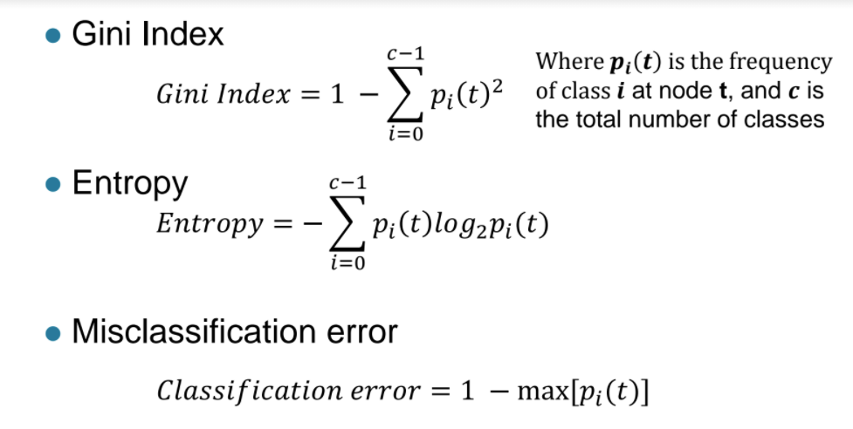
Measures of Node Impurity
Gini Index
𝑐 −1
Where 𝒑_{𝒊} 𝒕 is the frequency of class 𝒊 at node t, and 𝒄 is the total number of classes
𝐺𝑖𝑛𝑖 𝐼𝑛𝑑𝑒𝑥 = 1 − 𝑝_{𝑖} 𝑡
𝑖=0
2
Entropy
𝑐−1
𝐸𝑛𝑡𝑟𝑜𝑝𝑦 = − 𝑝_{𝑖} 𝑡 𝑙𝑜𝑔₂𝑝_{𝑖}(𝑡)
𝑖=0
Misclassification error
𝐶𝑙𝑎𝑠𝑠𝑖𝑓𝑖𝑐𝑎𝑡𝑖𝑜𝑛 𝑒𝑟𝑟𝑜𝑟 = 1 − max[𝑝_{𝑖} (𝑡)]

Slide 41
Finding the Best Split
Compute impurity measure (P) before splitting
Compute impurity measure (M) after splitting
Compute impurity measure of each child node
M is the weighted impurity of child nodes
Choose the attribute test condition that produces the highest gain
Gain = P - M
or equivalently, lowest impurity measure after splitting (M)

Slide 42
Finding the Best Split
Before Splitting:
C0 | N00
C1 | N01
P
A?
B?
Yes
No
Yes
No
Node N1
Node N2
Node N3
Node N4
C0 | N10
C1 | N11
C0 | N20
C1 | N21
C0 | N30
C1 | N31
C0 | N40
C1 | N41
M11
M12
M21
M22
M1
M2
Gain = P – M1
vs P – M2

Slide 43
Decision Tree Based Classification
Advantages:
Relatively inexpensive to construct
Extremely fast at classifying unknown records
Easy to interpret for small-sized trees
Robust to noise (especially when methods to avoid overfitting are
employed)
Can easily handle redundant attributes
Can easily handle irrelevant attributes (unless the attributes are interacting)
Disadvantages: .
Due to the greedy nature of splitting criterion, interacting attributes (that can distinguish between classes together but not individually) may be passed over in favor of other attributed that are less discriminating.
Each decision boundary involves only a single attribute

